Slide 1
BAN 502 Bromley Thornton Project Phase 1 2/16/26

Slide 2
Objectives…
In Phase 1, the mission is to take the given dataset and find potential predictors in failure.
This is done through focusing on…
Understanding Distributions of Failure
Finding Variables of Influence
Sighting Quality Issues in Data

Slide 3
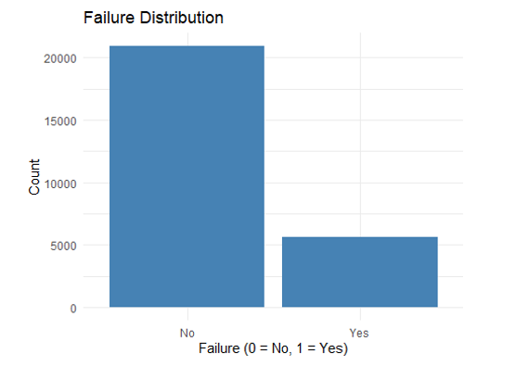
- Much Less Fail Than Don’t Fail - Predictive Modeling Should be Straightforward for Overall Distribution in Phase 2

Slide 4
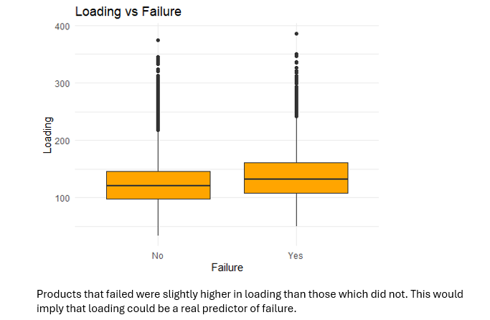

Slide 5
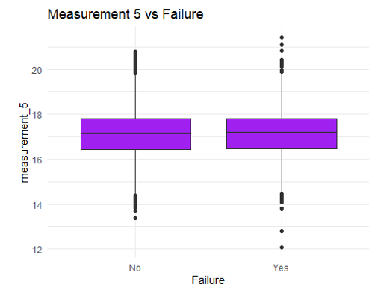
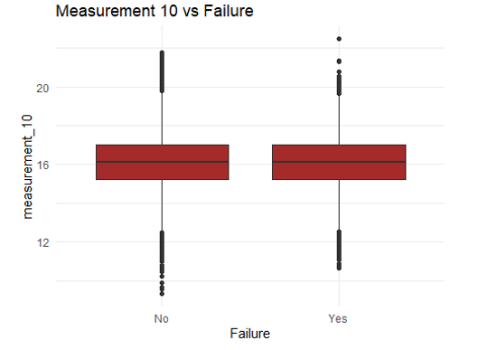
Separation is evident here. There are many outliers for both “yes” and “no” responses to failure. This could be statistically significant and a potential predictor in phase 2.

Slide 6

The Rundown…
Data quality is a little less than ideal. There are many missing variables. This will have to be taken care of in some fashion for phase 2 predictive work.
The most indicative or influential predictors appear to be “Loading”, “Measurement_5”, “Measurement_10” and even “Measurement_0” (which is not displayed in slides).

